Slide 1
Automatic Machine Learning with H2O AutoML
Bismayan Chakrabarti
Data Scientist- airisData Inc.

Slide 2

We are Hiring!!
Come talk to us if you are a data scientist/data engineer and want to do some exciting work!

Slide 3

Who am I?
Data Scientist at airis.Data
Basic academic background – Computational Physics
Picked up almost all of my data science machine learning knowledge from the web tutorials/ online courses.
Moral of the Story- The internet is an awesome tool!

Slide 4
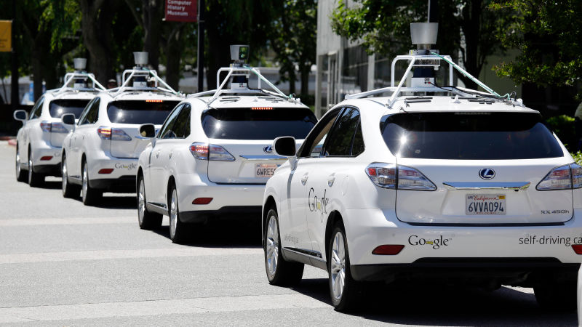
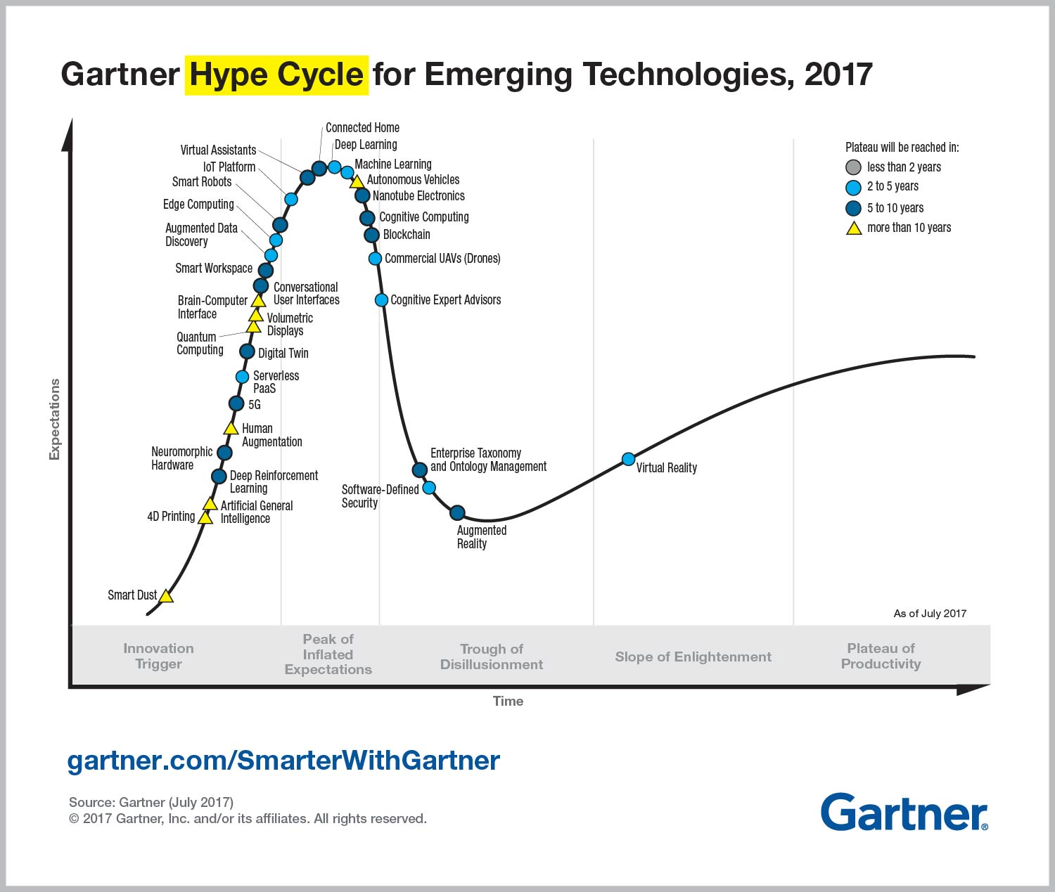
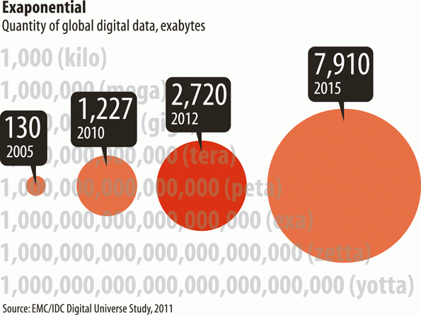


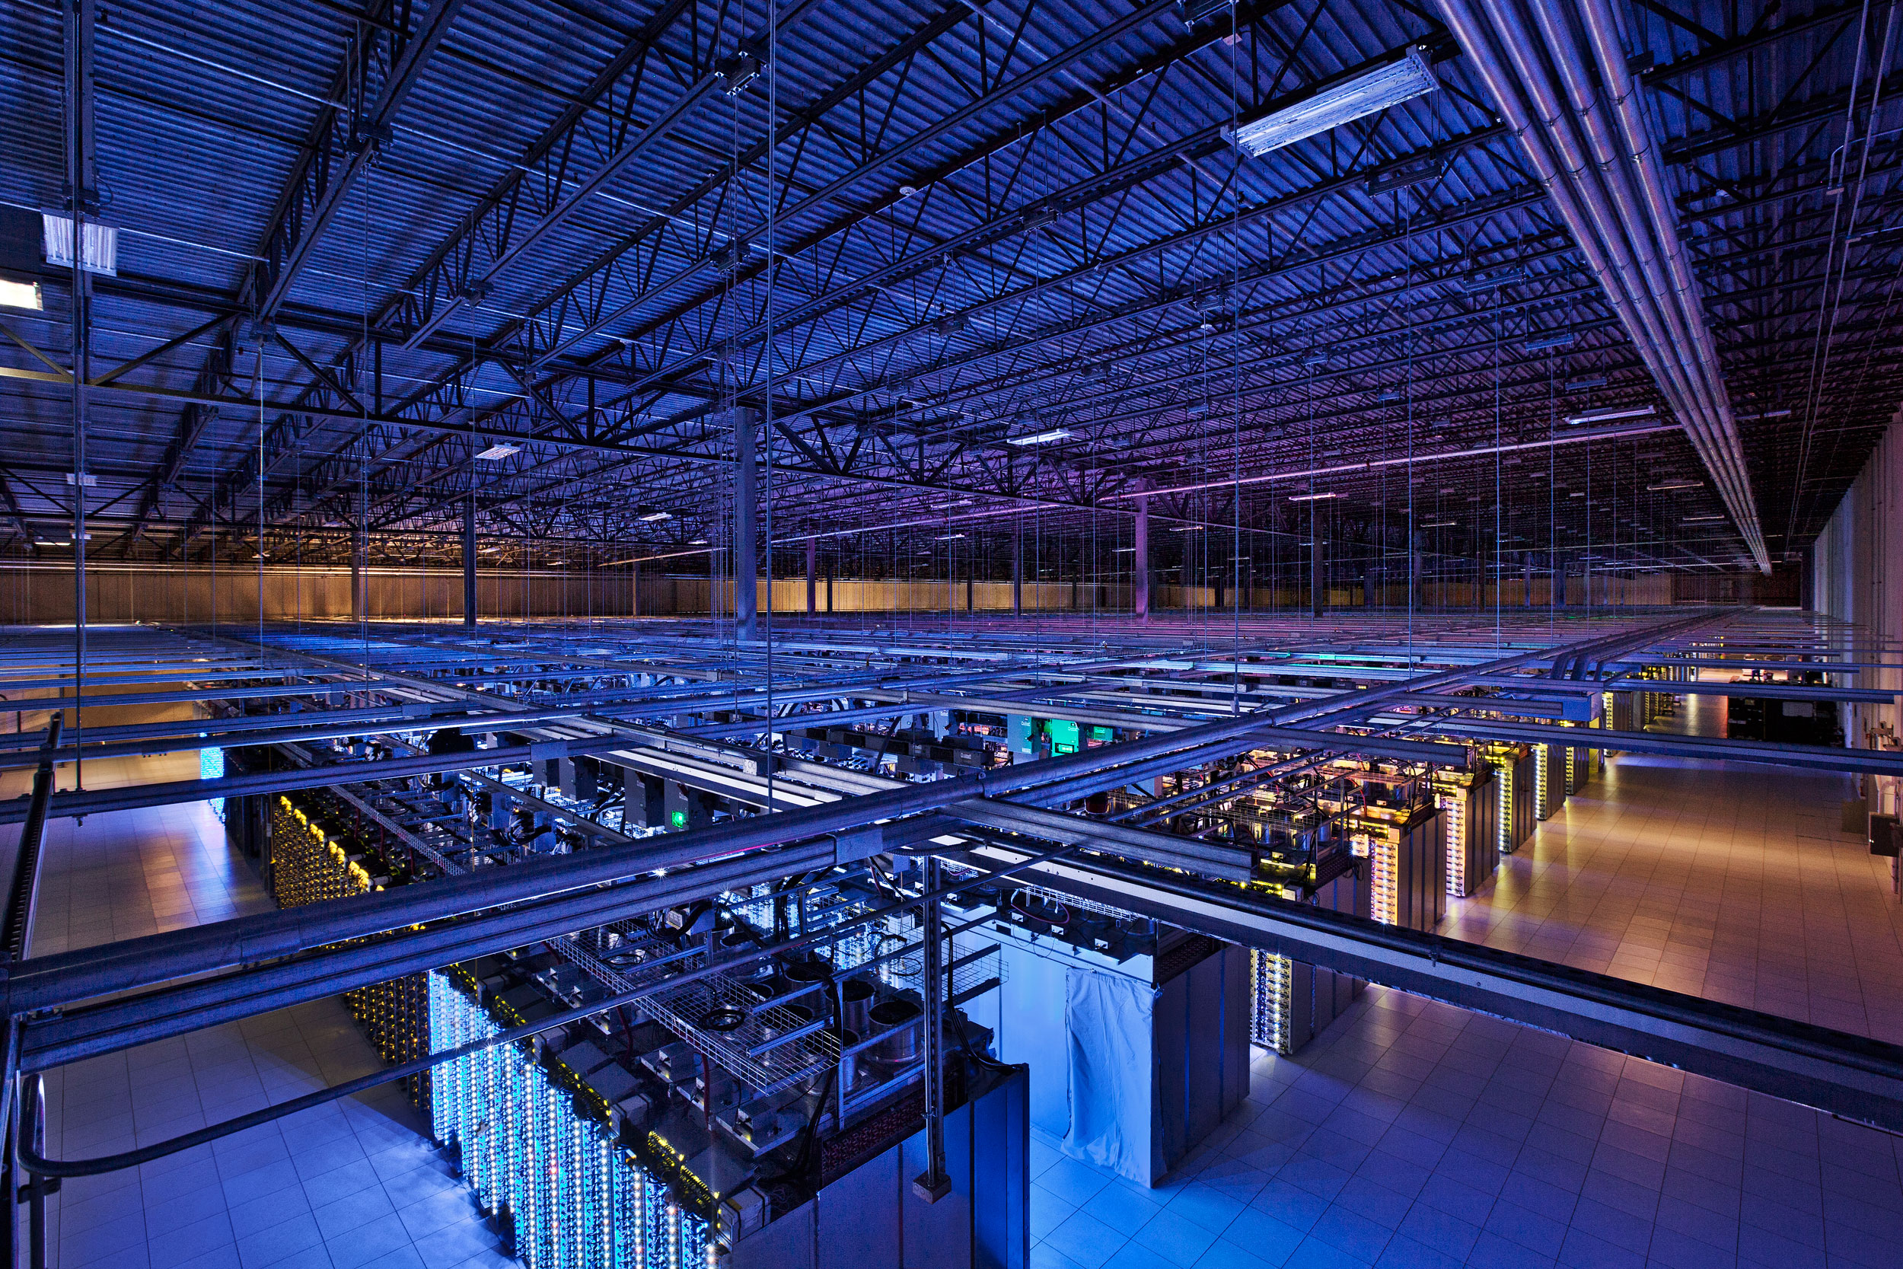

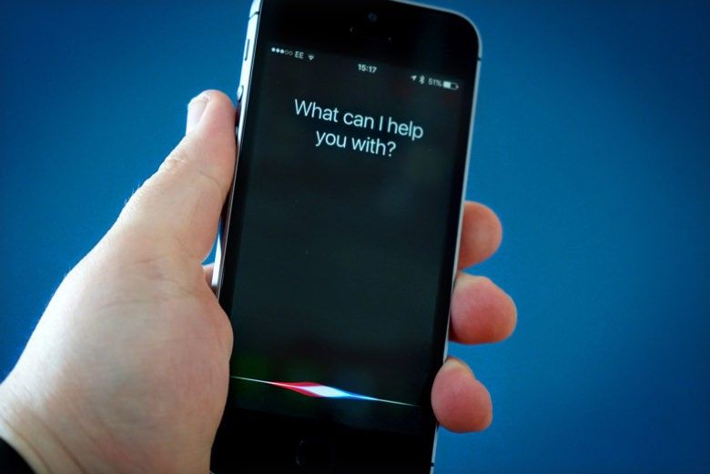
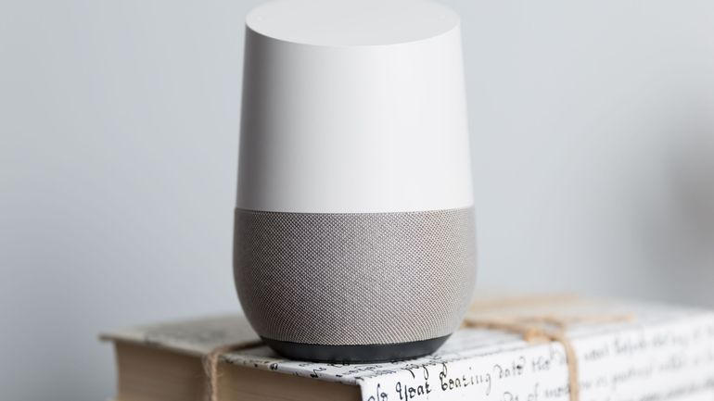
Machine learning-Why the hype?
Data Science / Machine Learning – one of the most fashionable jobs right now
Companies are sitting on tons of data and want to put it to good use
Most companies are expanding their data infrastructure
Machine Learning/ Deep learning already part of our lives.
Word of Warning- Probably peak of ML hype cycle.

Slide 5
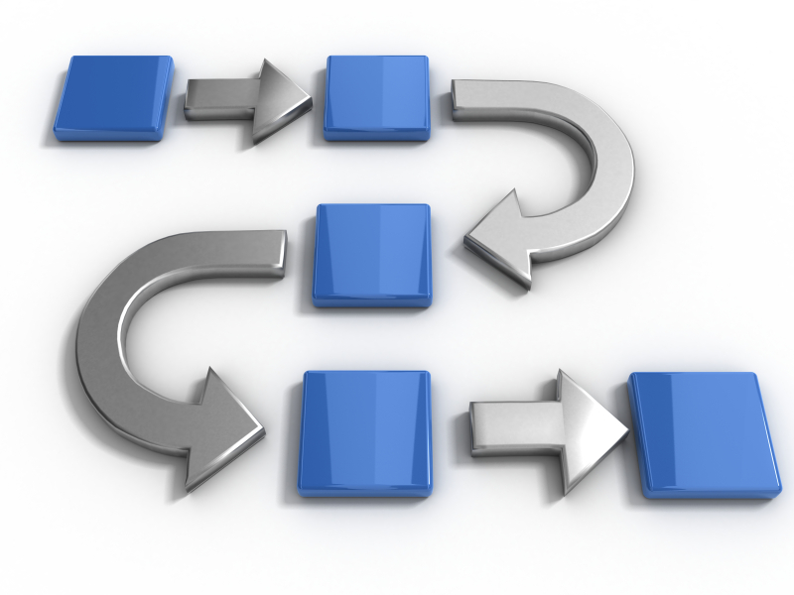
The Main Stages of Solving a Machine Learning Problem
Get a data scientist!
Give him/ her your data and pose a well thought-out question
The Data Scientist then (usually) -
Maps the question to an ML problem
Gathers the data
Cleans the Data to obtain basic features
Performs feature engineering
Picks and tunes a Machine Learning model/ models
Improves accuracy by repeating above steps
Makes sense of the results
Translates results to business-speak
Deploys Model

Slide 6

Why do we need Automatic machine learning?
Higher Demand than Supply of Data Scientists
High barrier to Entry
A lot of the work is repetitive and time consuming
Difficult to keep up with fast paced developments.
Automatic Machine Learning helps both novices and experienced Data Scientists

Slide 7

Why do we need Automatic machine learning?
For Novices-
Helps them do useful work without spending months learning all the algorithms
No need to learn all the Math behind the algorithms
“Big Green Button” approach to ML
For experienced Data Scientists-
Most of the tasks involved are repetitive and could be automated
No Need to remember the abundance of hyperparameters that go into every model
Provides benchmarks for their own more complicated models

Slide 8
So what is Automatic Machine Learning??
The end goal is to automate the entire ML workflow
Less Advanced implementations usually concentrate on-
Automatic handling of missing values
Automatic model/metric selection (non-dataset dependent)
Automatic hyperparameter tuning
Automatic Ensembling
More advanced implementations working on-
Dataset dependent model selection
Automatic feature generation and selection
Automatic generation of reports / graphs based on results
Putting Data Scientists out of business

Slide 9
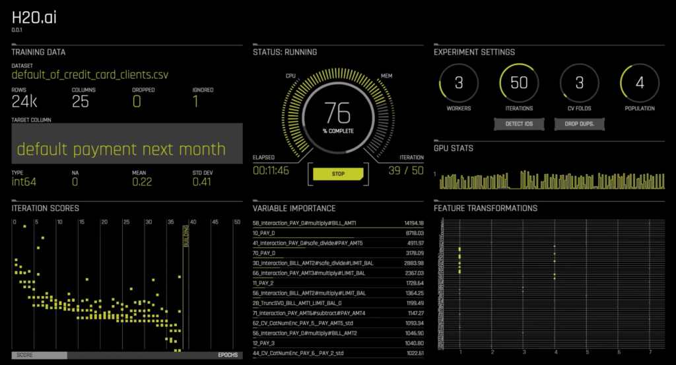

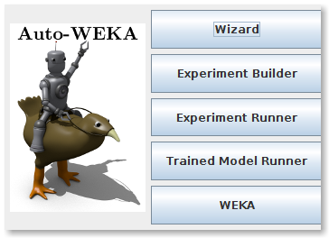
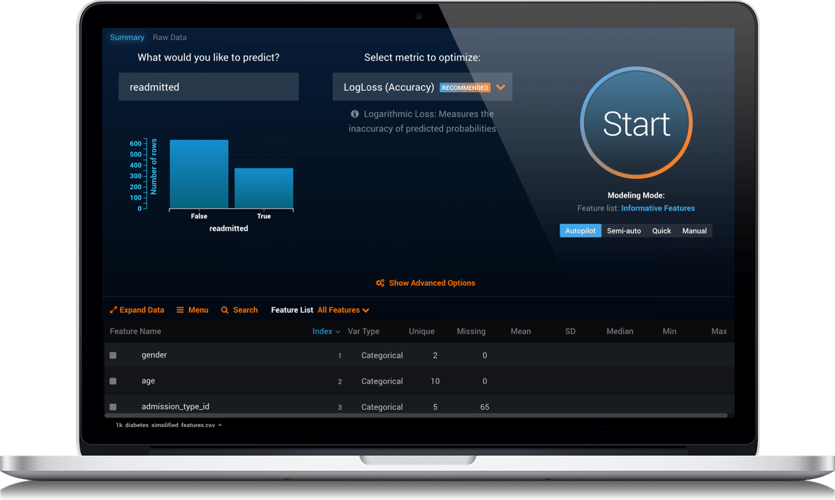

An incomplete list of automatic ML packages
Auto-sklearn (extension to sklearn , open source)
H2o- AutoML (our weapon of choice for today)
H2o- Driverless AI (much more fancy, not open source)
DataRobot (highly advanced, not free)
Auto-WEKA
TPOT

Slide 10

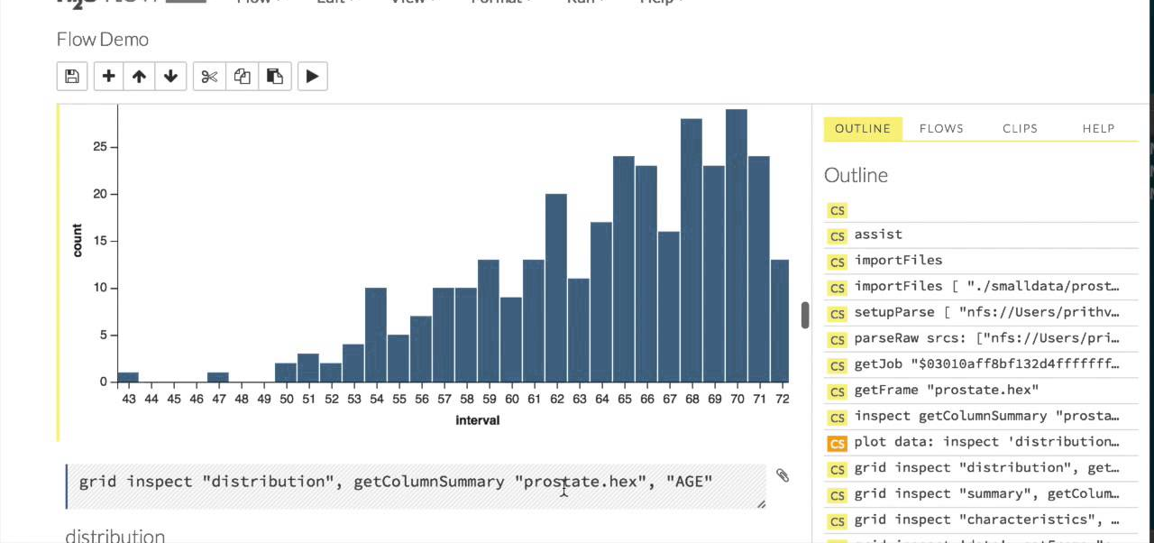
Our Focus- H2O AutoML
H2o- a mature machine learning platform
runs on JVM
Most of it is open source
Advanced integration with Spark/ Hadoop etc.- distributed ML capabilities
API in R/ Python/ Scala
Capable of exporting Models coded in other languages as Java classes
H2o Flow- GUI for Machine learning model building
H2o AutoML
Provides point and click automatic machine learning through Flow
Can handle both Regression and (Binary) Classification
Free and open source
Lesser Version of Driverless AI

Slide 11
Enough talk…now let’s get started
What you will need-:
Mandatory-:
(Preferably) the latest version of H2O – 3.14.0.6
Non-Ancient Internet Browser
A working Java Implementation
Optional-
For python integration install h2o python bindings (instructions on webpage)
Pandas
Jupyter notebook
Download Datasets from:
Bad Loans DataSets
https://raw.githubusercontent.com/h2oai/app-consumer-loan/master/data/loan.csv
House Price Dataset:
https://www.kaggle.com/c/house-prices-advanced-regression-techniques/data
Or you could download H2O and the datasets from-
https://github.com/bismayan/meetup_autoML

Slide 12
Thank You

